Slide 1

FAKE NEWS DETECTION
Presented By:
Sri Ram Commuri

Slide 2
Business Problem Framing
Need to classify if a news is fake or not, based on the Author’s name, Headline and the actual content of the article.
The authenticity of Information has become a longstanding issue affecting businesses and society, both for printed and digital media.
On social networks, the reach and effects of information spread occur at such a fast pace and so amplified that distorted, inaccurate, or false information acquires a tremendous potential to cause real-world impacts, within minutes, for millions of users.
Recently, several public concerns about this problem and some approaches to mitigate the problem were expressed

Slide 3
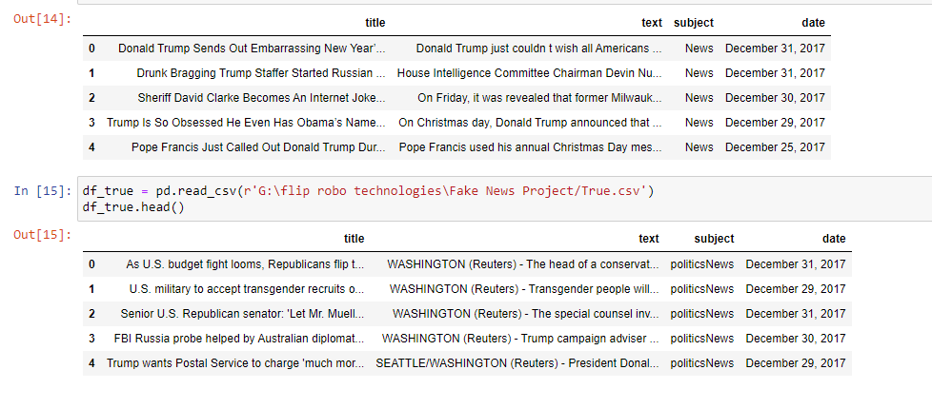
Dataset
The figure shows how the given dataset looks like

Slide 4
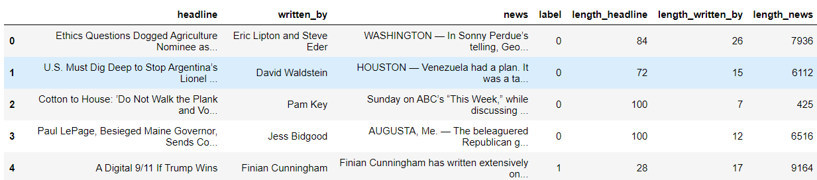
Calculated Lengths of Features

Slide 5
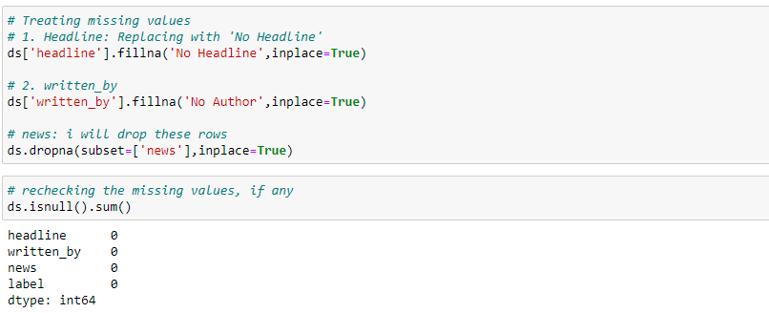
HANDLING MISSING VALUES

Slide 6
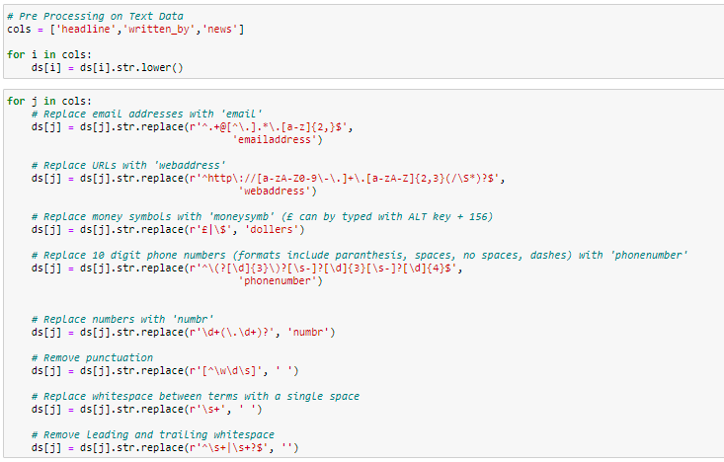
Using NLP to Solve Problem
Here the idea is to vectorize the contents so that the meaning of the article can be understood by the machine. The following pre-processing steps were done:

Slide 7
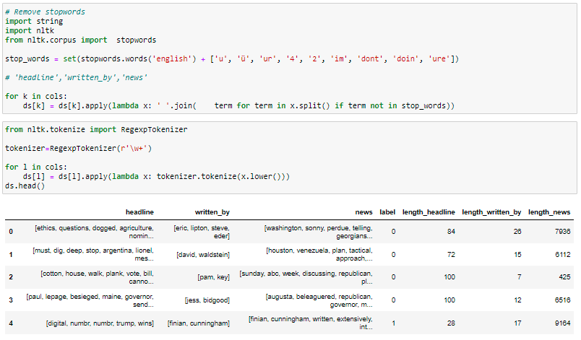
Stop Words Removal
We need to remove words like for, of, the etc. which do not actually add to the context so that our processing speed is reduced

Slide 8
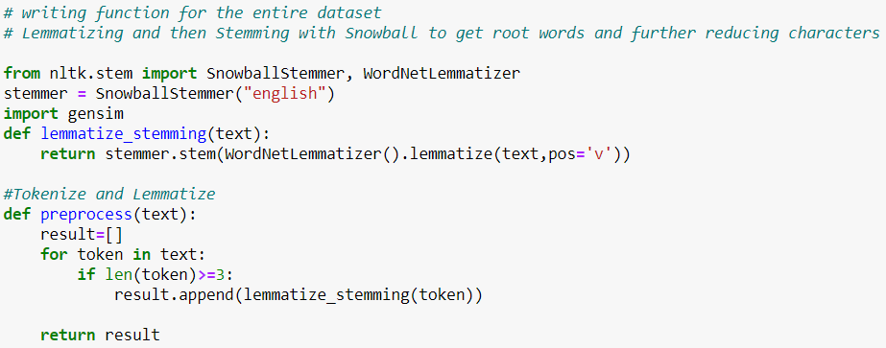
lemmatization and stemming have been performed on the features – Headline and news. This is done to find the root words.

Slide 9
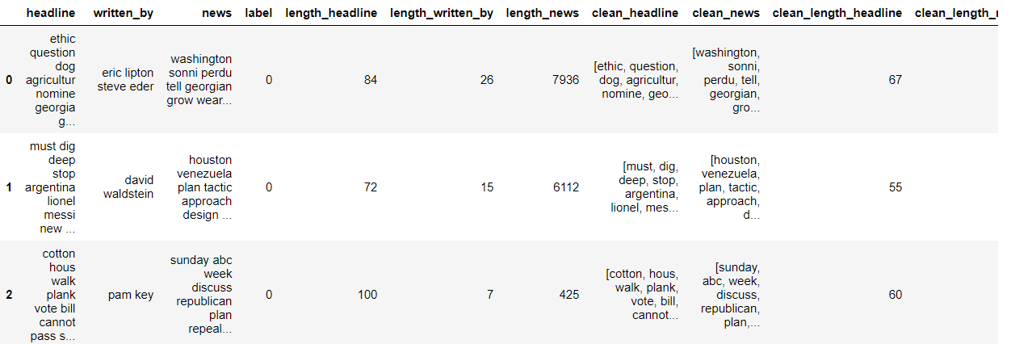
Finally, we can see the counts of actual data and data after pre-processing

Slide 10
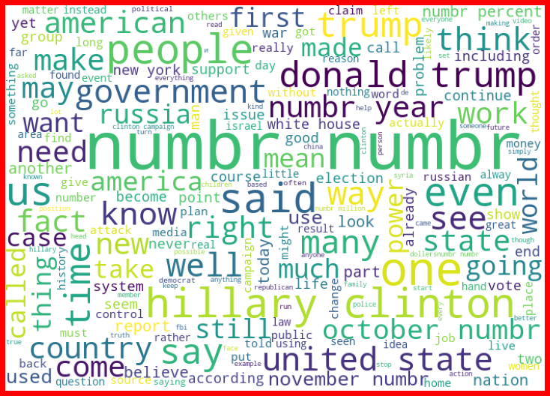
Word Cloud for Fake News for News Column

Slide 11
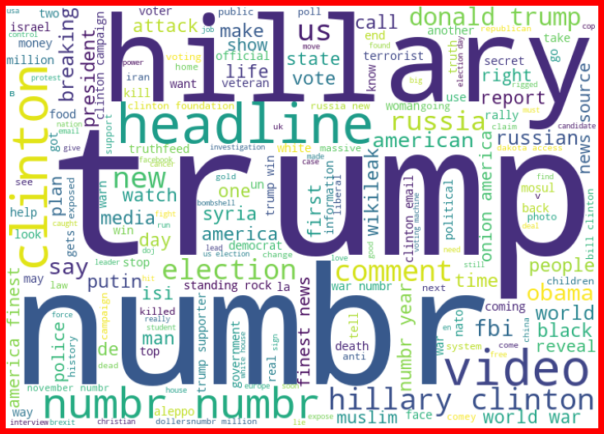
Word Cloud for Fake News for Headline Column

Slide 12
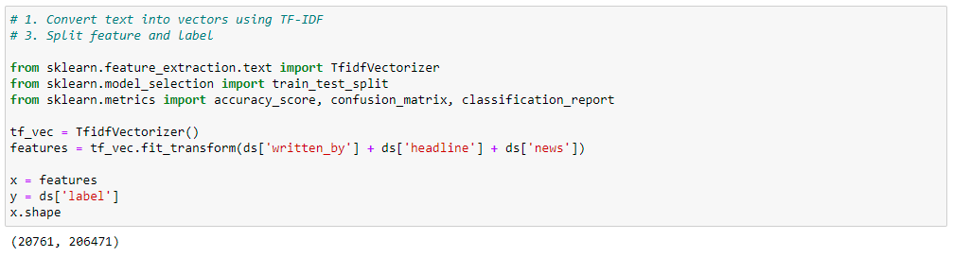
Next, I have vectorized using tf-idf vectorizer so that words are arranged in a 2-d area based on similarity or difference in their meaning
Also, prepared X and y variables for model building

Slide 13
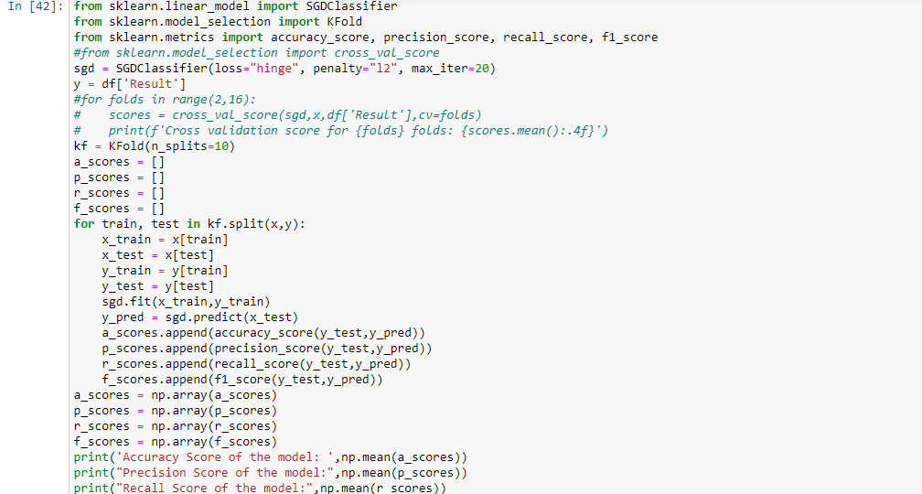
Let’s have a look at the Model Performances

Slide 14
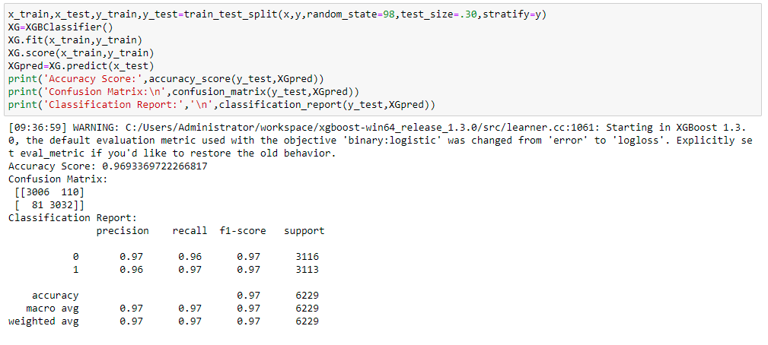
Final Model

Slide 15
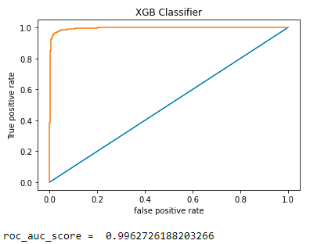
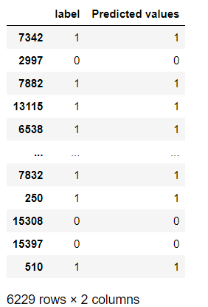
Roc Auc Score and Predicted Values

